Slide 1
Cybersecurity in IoT
A machine learning approach
Building machine learning models using network traffic data to detect cyber threats in IoT infrastructures
Nikitas Tsinnas - Electrical & Computer Engineering NTUA October 2023

Slide 2
Objectives
Business Understanding
Business Domain
Build an Experience Canvas
Technical
Solution design overview
Introduction to Deep Learning
Classification models development
Kaggle community
Data Collection
Data Preprocessing
Classification ML Models
Classification DL Models
Models’ Performance Comparison
Future
Deployment & ML-ops
Additional
MQTT protocol familiarization
Securing over TLS/SSL

Slide 3
Business Understanding

Slide 4
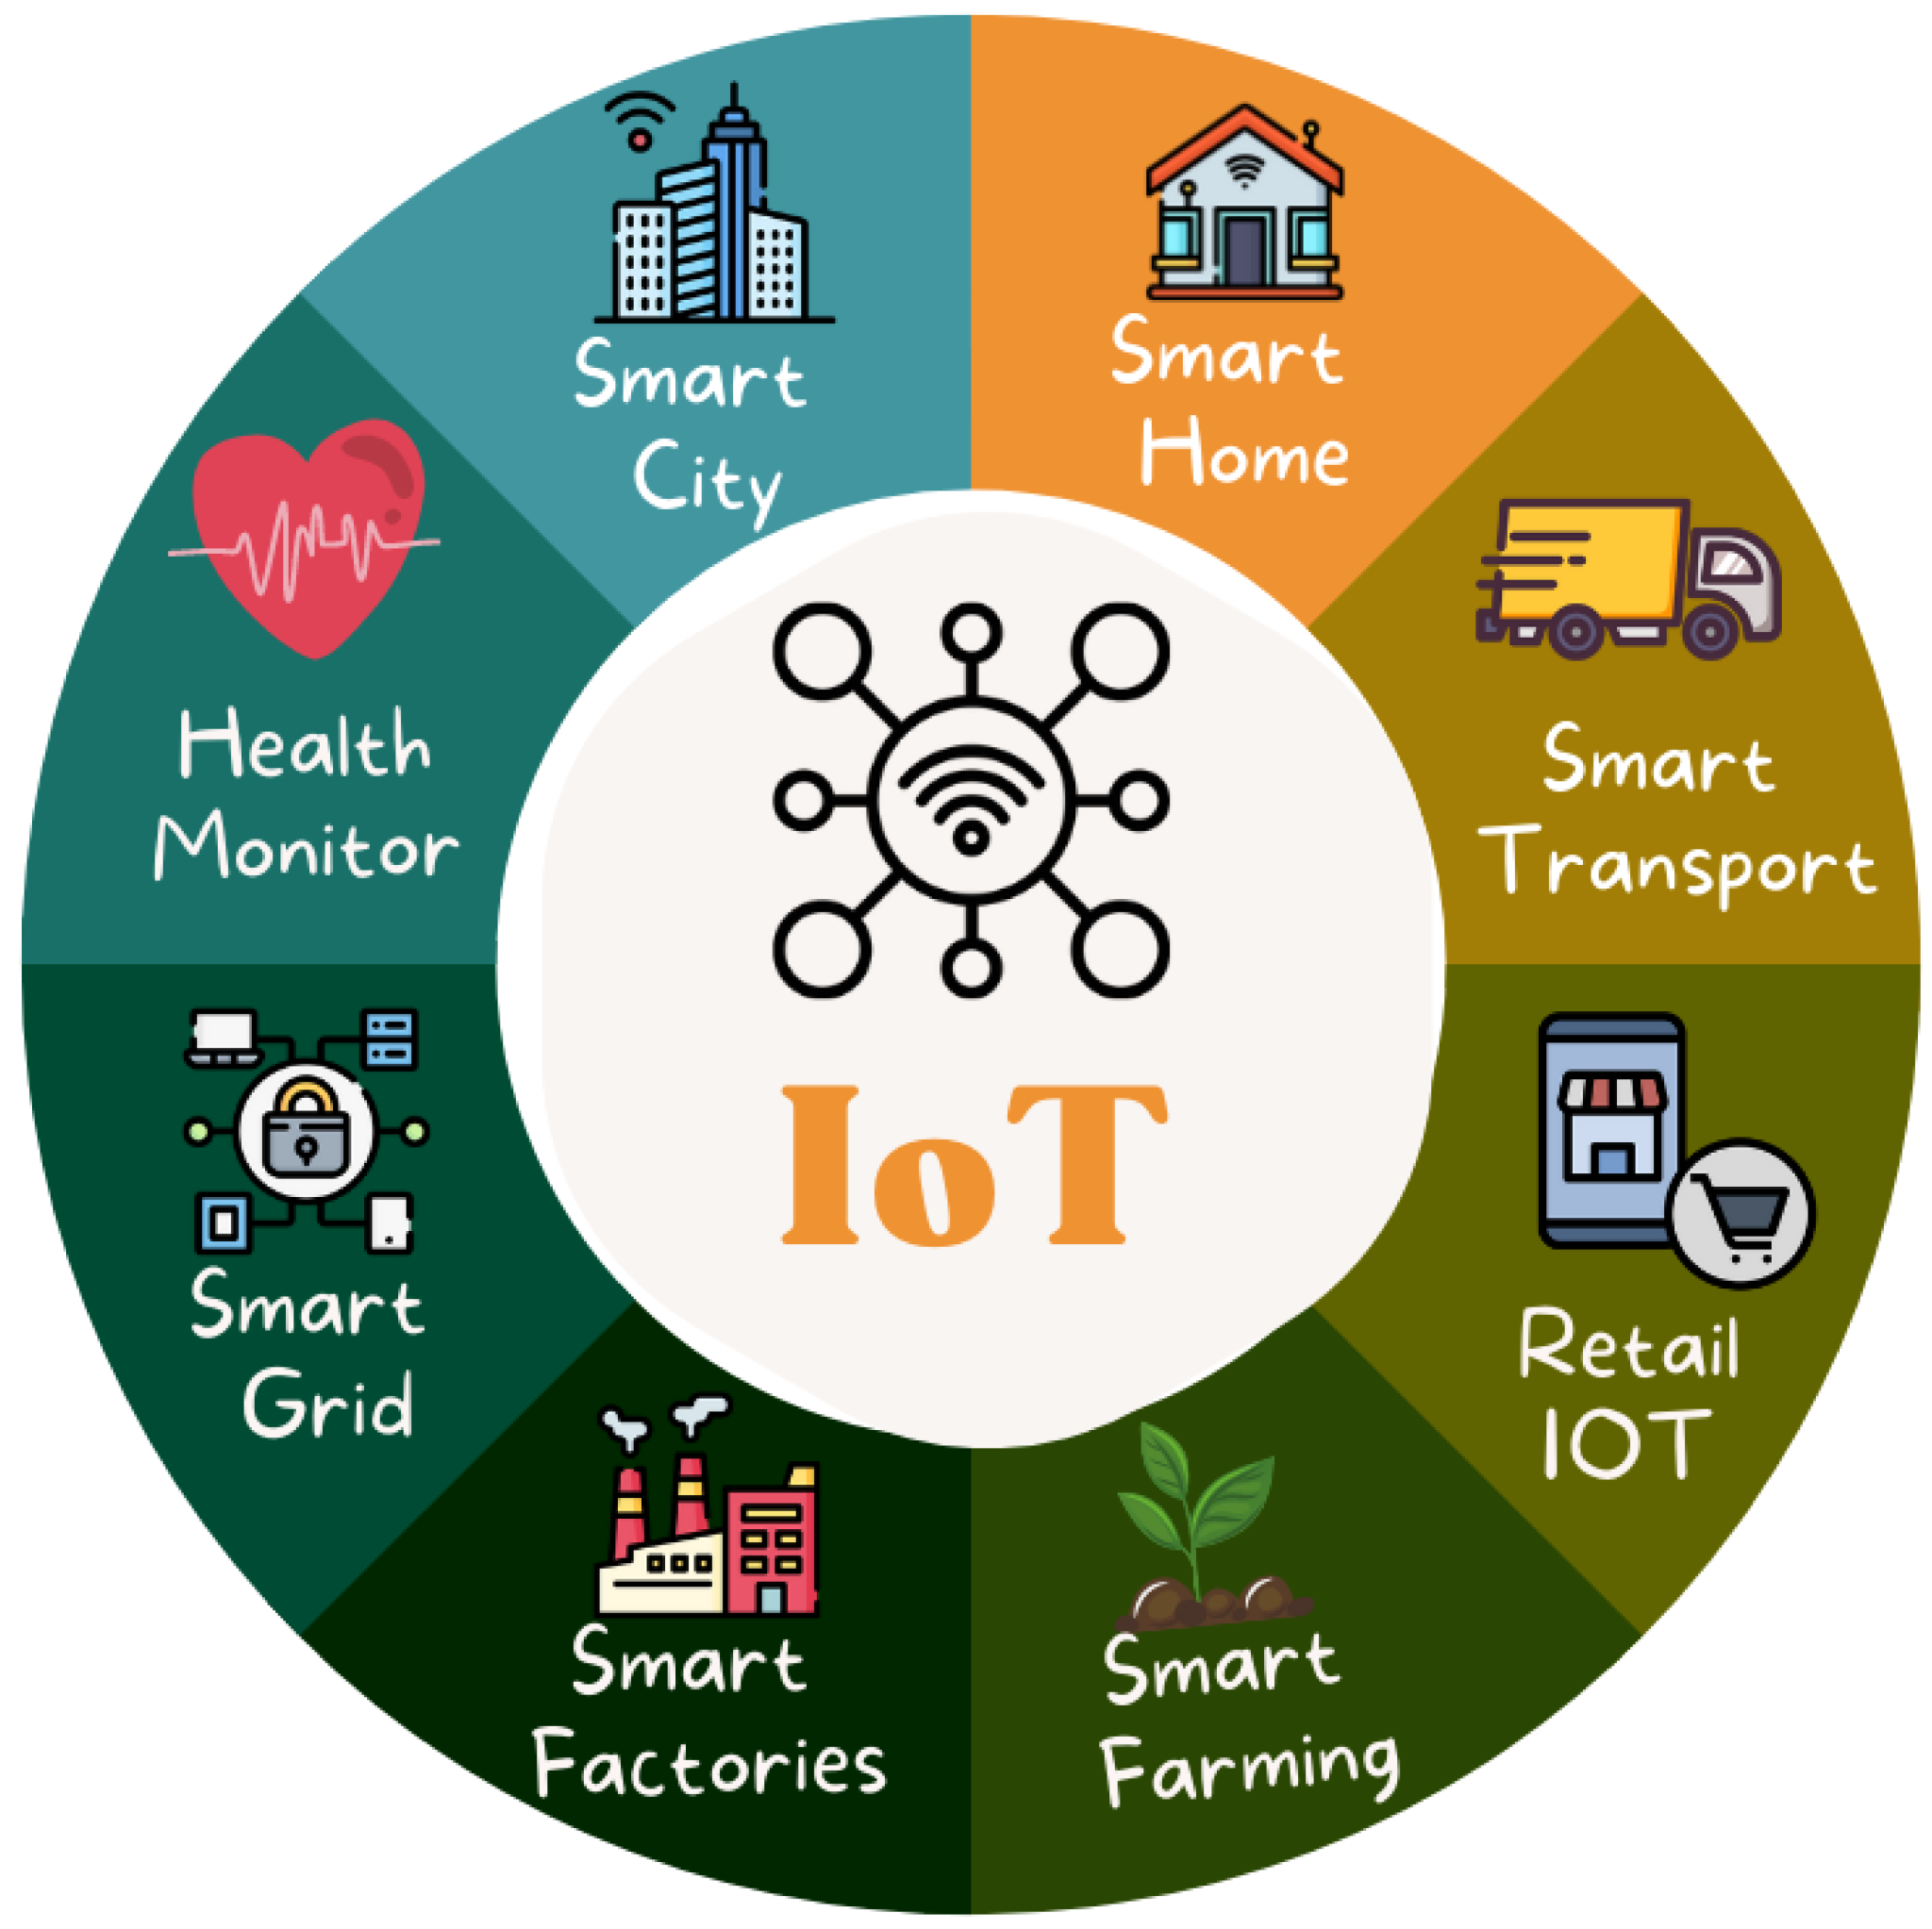
Business domain
Internet Of Things
IoT involves adding internet connectivity for monitoring and control to a system of many devices. (E.g. smart homes, smart grids, smart cities).
Cybersecurity in IoT
Due to the unconventional manufacturing of IoT devices and the vast amount of data they handle, there is a significant and constant threat of cyber attacks that can harm the system physically and its operators economically.
Data Science
Using machine learning to develop models for early intrusion detection. Minimizes human intervention and optimize accuracy and efficiency.
AI
Data Science
ML
DL

Slide 5
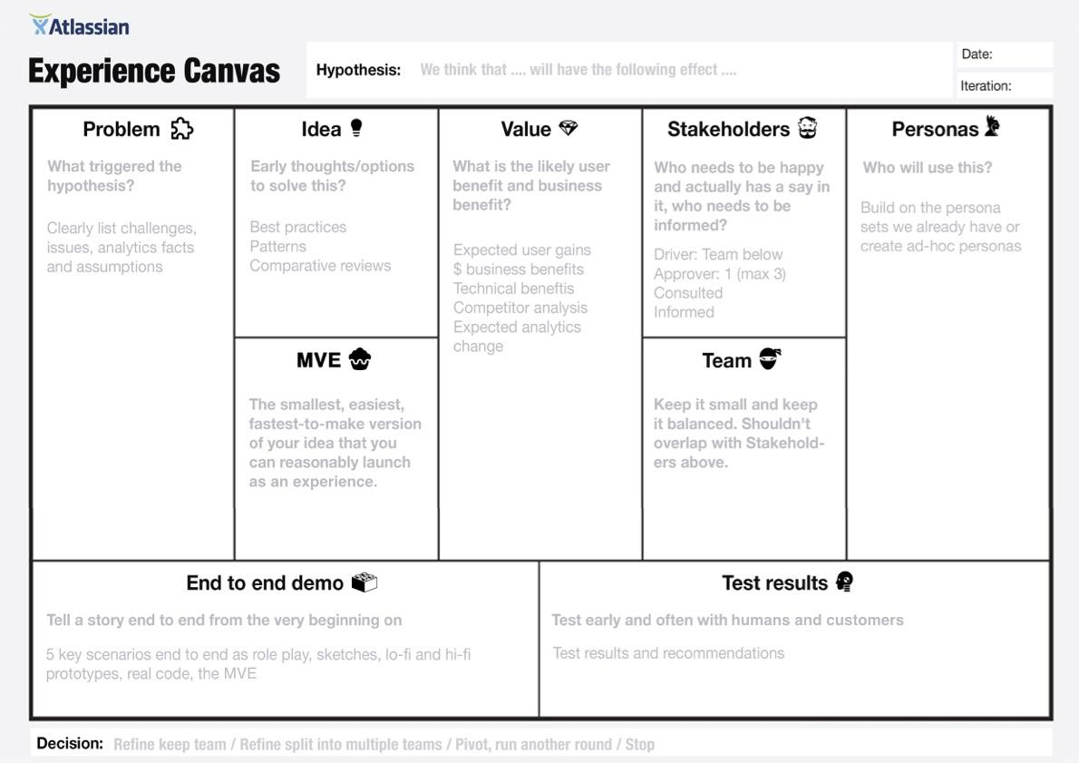
Experience canvas
What is it?
By atlassian team playbook free workshop resources.
Inspired by the classic lean canvas, an experience canvas helps clarify what problem your project is trying to solve, the customer(s) you’re solving it for, and what success looks like.
Uploaded File

Slide 6
Technical

Slide 7
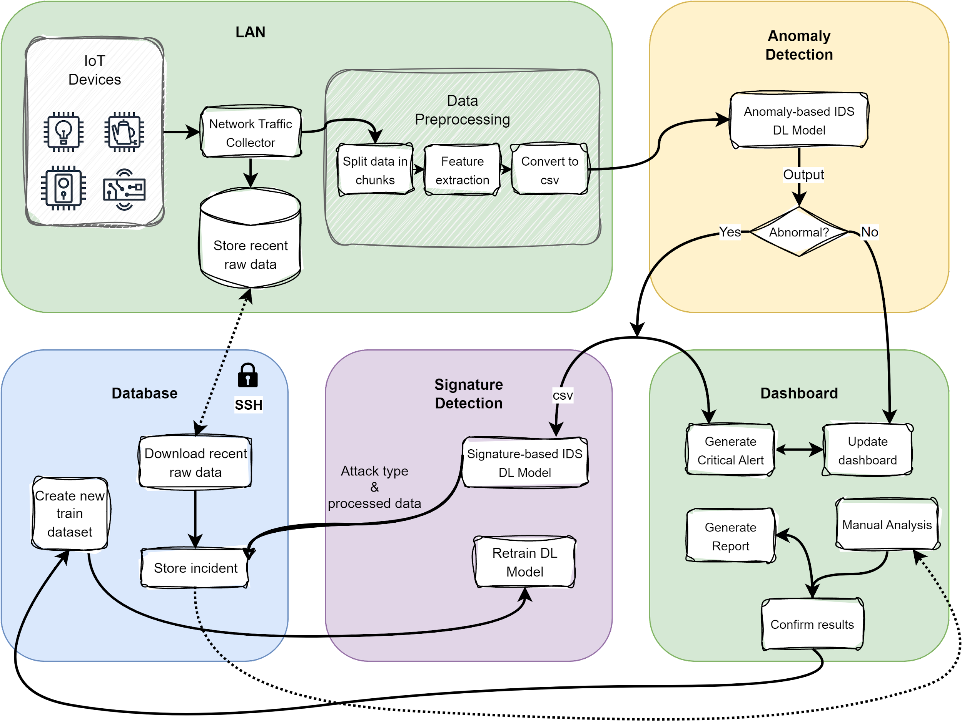
Solution design
Data flow diagram
Data flow representation from the generation of the traffic data to the update of a GUI dashboard. This is an overview of the solution design.

Slide 8
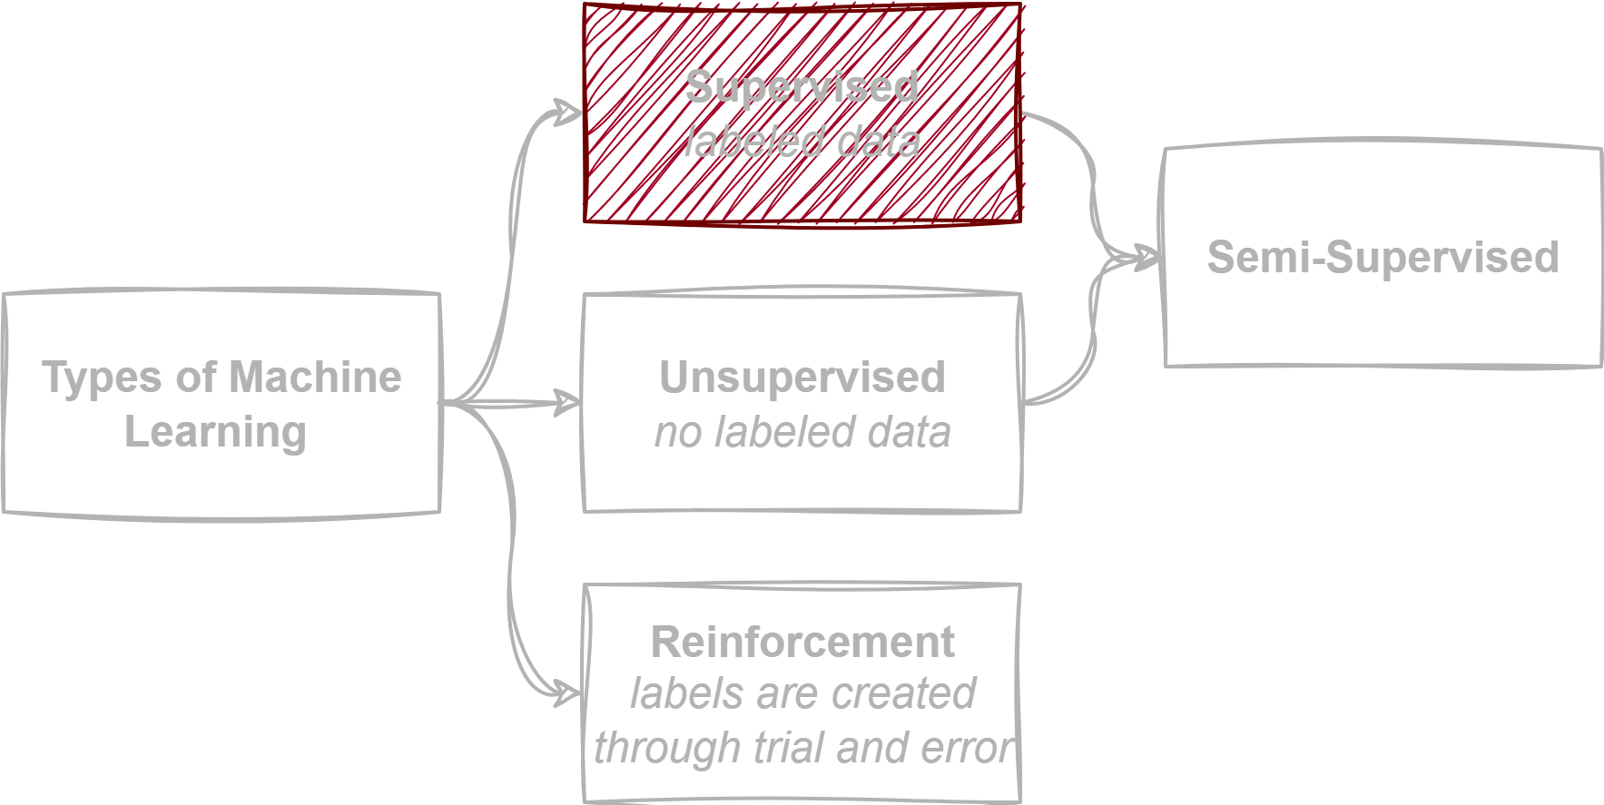
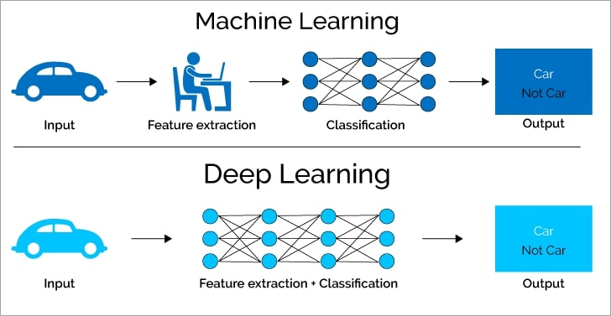
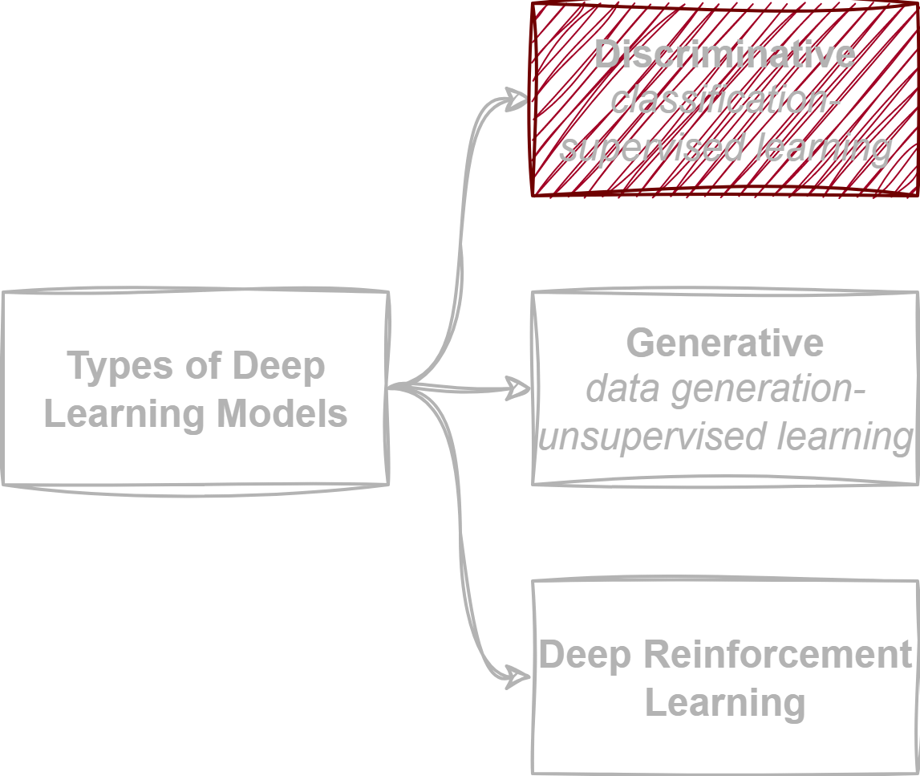
Introduction to Deep Learning
Less human intervention and more precision But needs way more data!

Slide 9


Kaggle community
Kaggle is a ML and Data Science Community. It enables users to:
Find and publish datasets
Explore and build models in a web-based data science environment
Work with other data scientists and machine learning engineers
Enter competitions to solve data science challenges

Slide 10
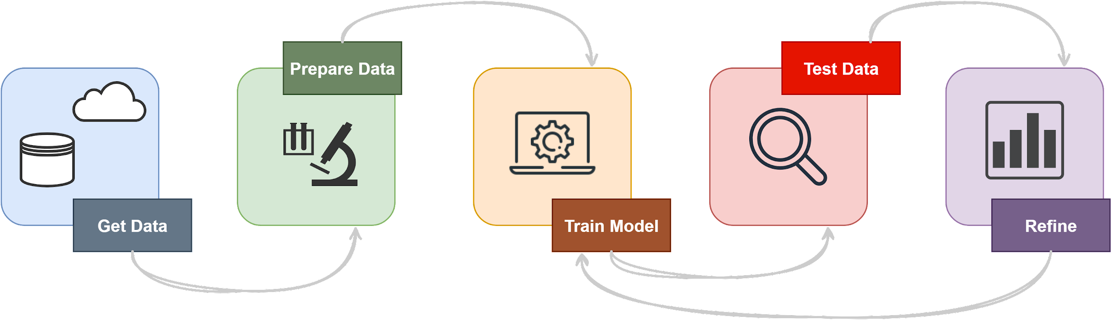
Classification models development

Slide 11
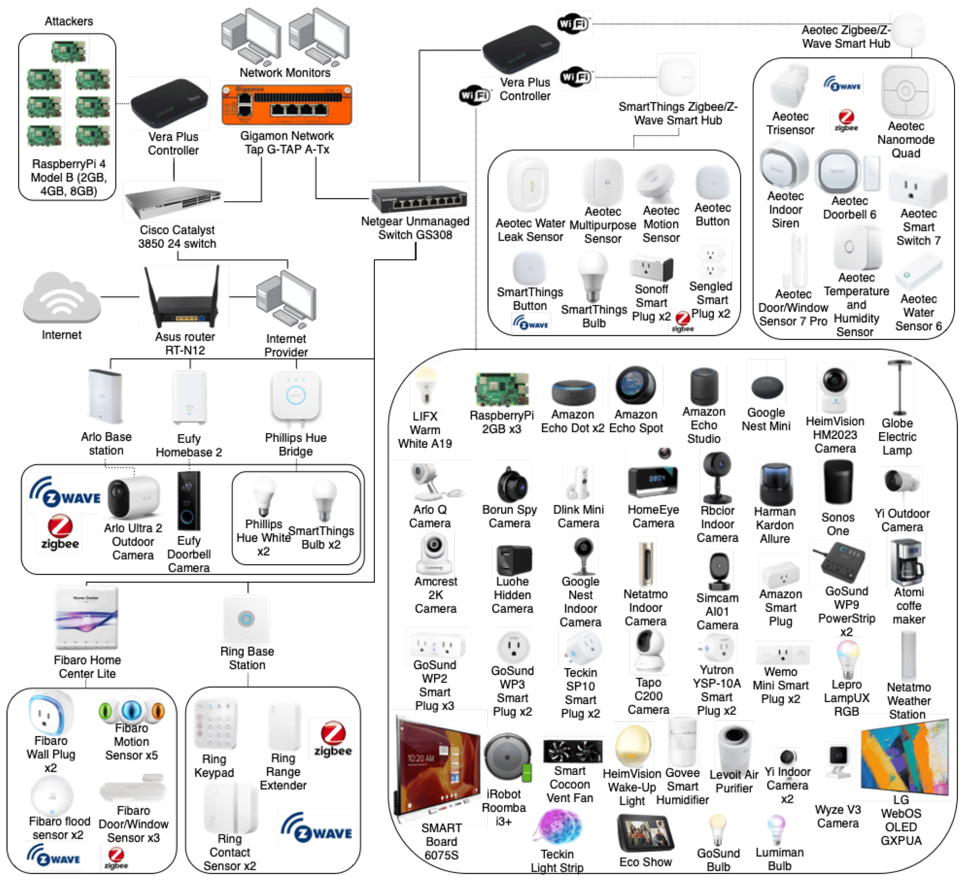
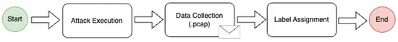
Data collection
CICIoT2023 Dataset :
A real-time dataset and benchmark for large-scale attacks in IoT environment.
33 attacks divided into 7 classes
IoT topology of 105 devices
After each attack, all the network traffic was labeled accordingly

Slide 12
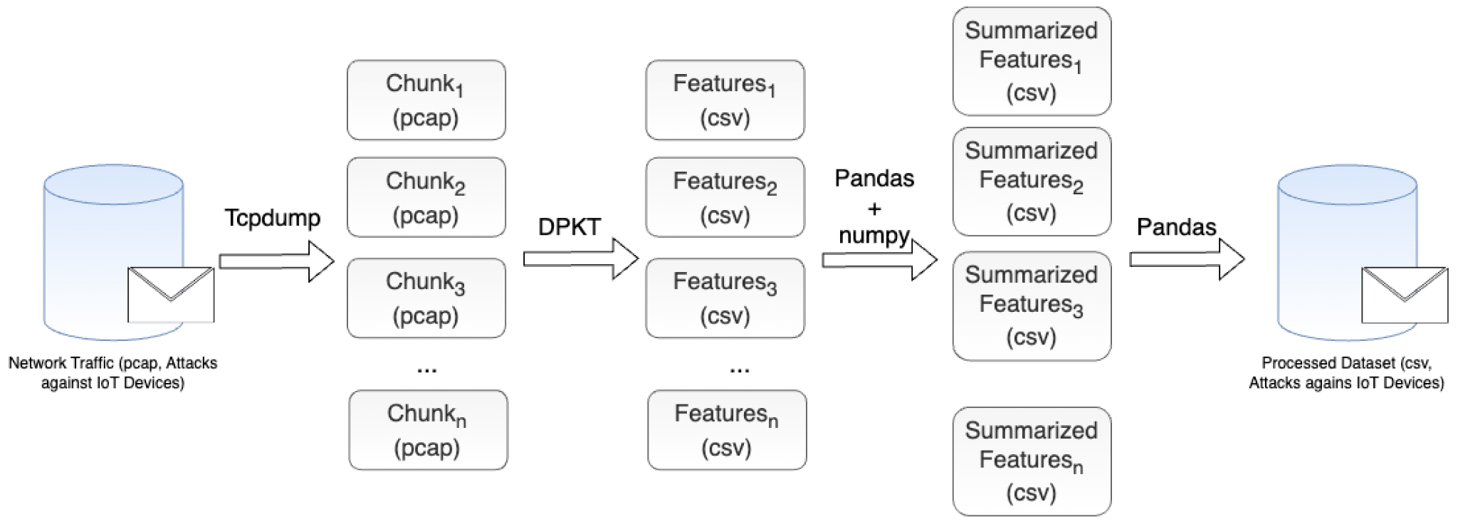
Data Preprocessing: Feature Extraction
Raw data is in pcap format. In first phase of preprocessing, we have to get the raw network data and extract data rows that have meaning in csv format. In order to achieve this, we used the proposed processed dataset, which connects the traffic in network flows to csv rows of 47 columns (features) already extracted using the DPKT tool.

Slide 13
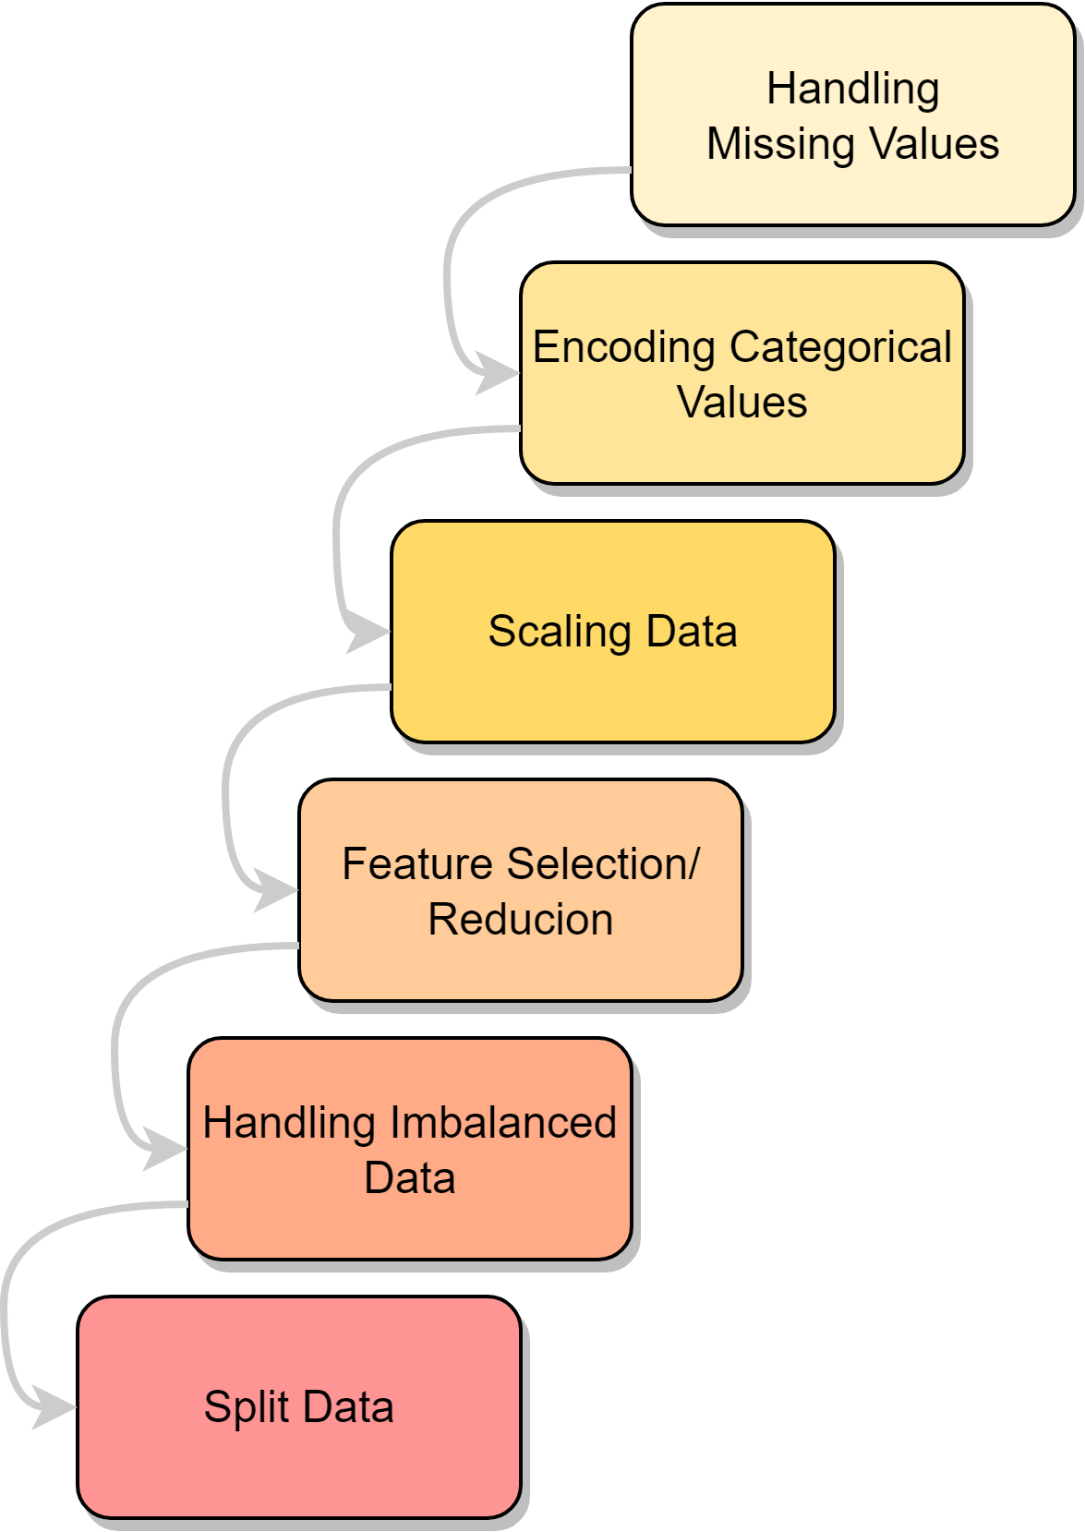
Data Preprocessing: Preparation for Model Training
Data preprocessing involves cleaning, transforming, and organizing raw data into a format suitable for analysis or modeling.
Effective data preprocessing can significantly impact the quality and performance of the models, making it a critical step in the data science and machine learning workflow.

Slide 14
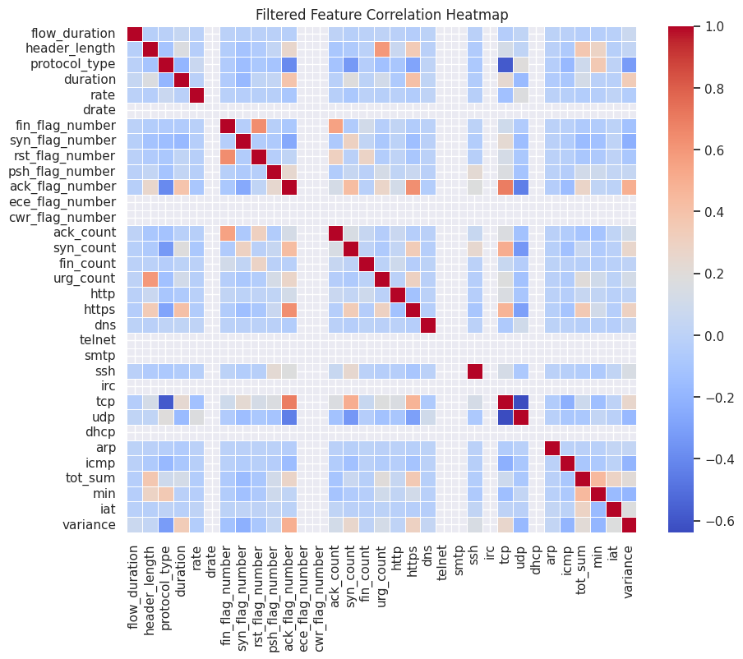
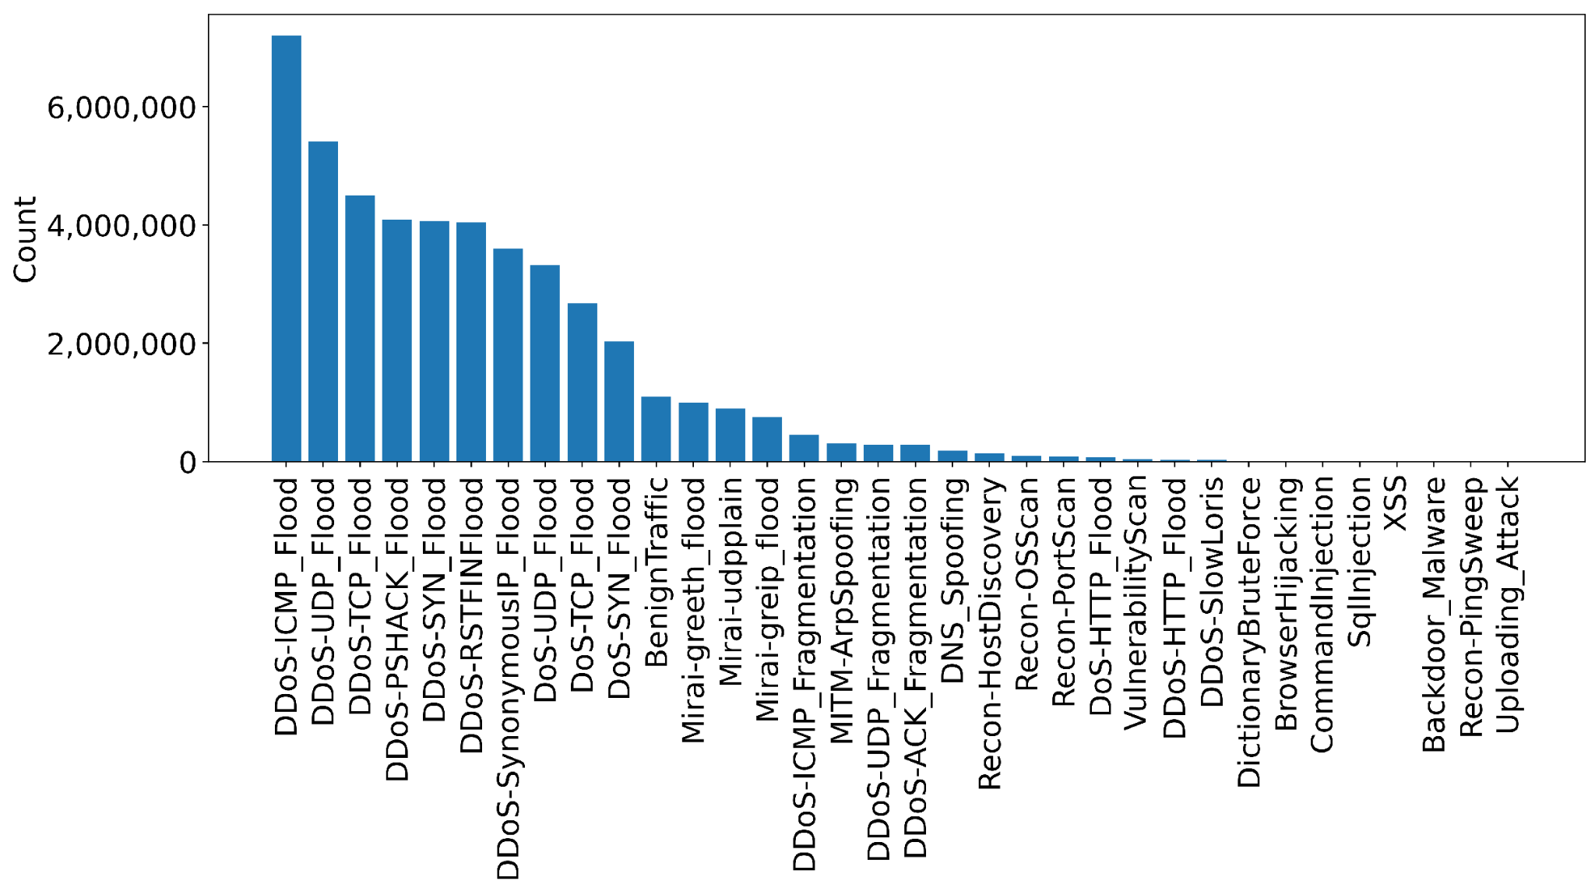
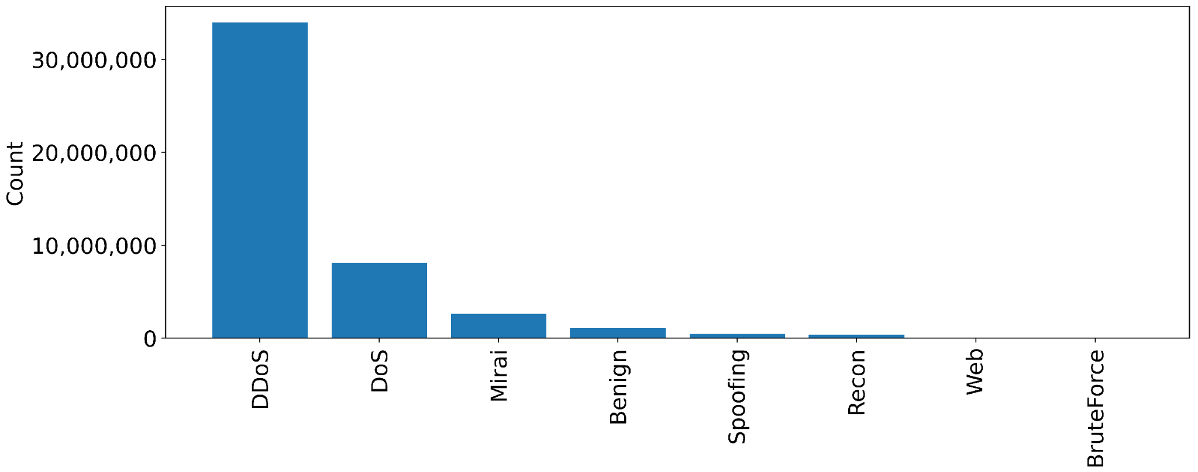
Data exploration
These are the attack types and classes distribution in the dataset.
DDoS, DoS by their nature produce more traffic. We have to handle this imbalance at preprocessing because we do not want our model to be biased.

Slide 15


Preparation for Model Training: Scaling Data
Why?
This is done to facilitate data analysis and modeling, and to reduce the impact of different scales on the accuracy of machine learning models.
How?
Normalization is a scaling technique in which values are shifted and rescaled so that they end up ranging between 0 and 1.
Standardization is another scaling method where the values are centered around the mean with a unit standard deviation.
 | Precision | Recall | Support
Normalization | 0.66 | 0.64 | 0.64
Standardization | 0.70 | 0.67 | 0.67
For the 7-class problem using common NN

Slide 16
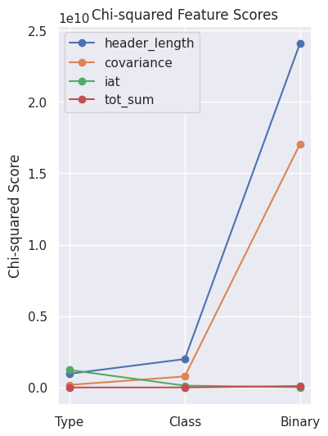
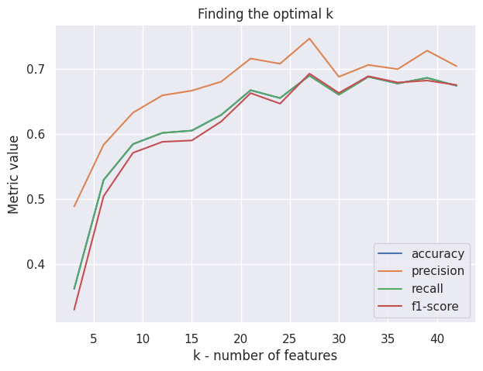
Preparation for Model Training: Feature Selection
Why?
Reduces Overfitting: Less redundant data means less possibility of making decisions based on redundant data/noise.
Improves Accuracy: Less misleading data means modeling accuracy improves.
Reduces Training Time: Less data means that algorithms train faster.
How? Chi2 function is a statistical hypothesis test. It is used to compute the correlation between the class values and the feature values.

Slide 17
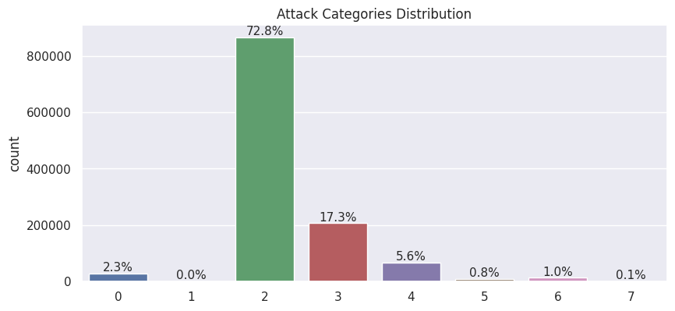
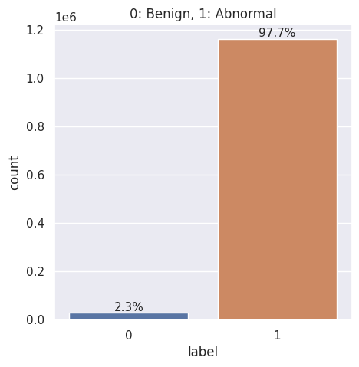
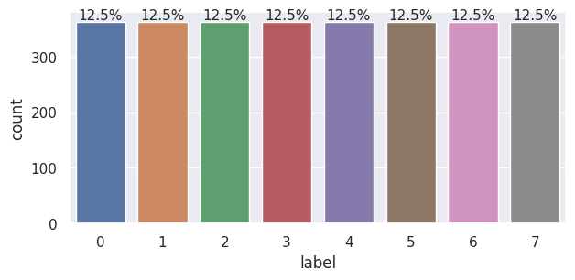
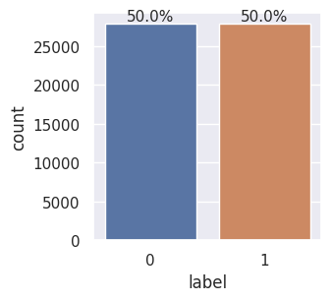
Preparation for Model Training: Handling Imbalanced Data
Why?
Models may exhibit bias toward the majority class, resulting in poor predictions for the minority class.
How?
Oversampling minority class
Undersampling majority class
Generate Synthetic Samples (SMOTE - Synthetic Minority Oversampling Technique algorithm)
Undersampling
Undersampling

Slide 18
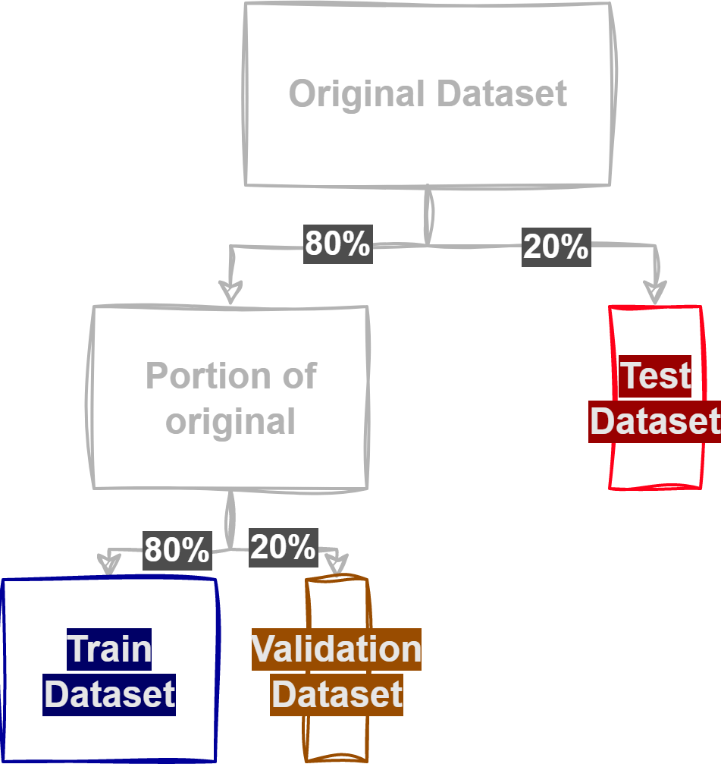
Preparation for Model Training: Split Data
We split the available data in separate datasets. The following proportions are the most common.
Train 64% of original To actually train the model
Validation 16% of original To validate the correct functioning of the training process
Test 20% of original To test the model performance

Slide 19
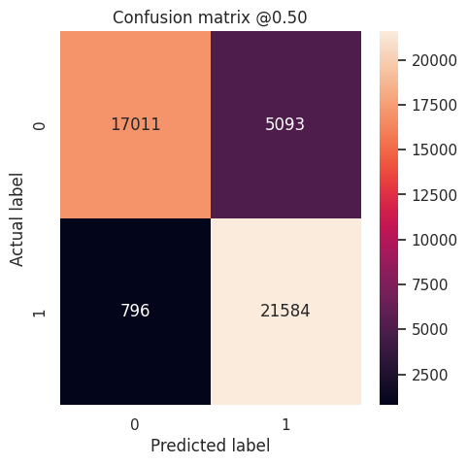
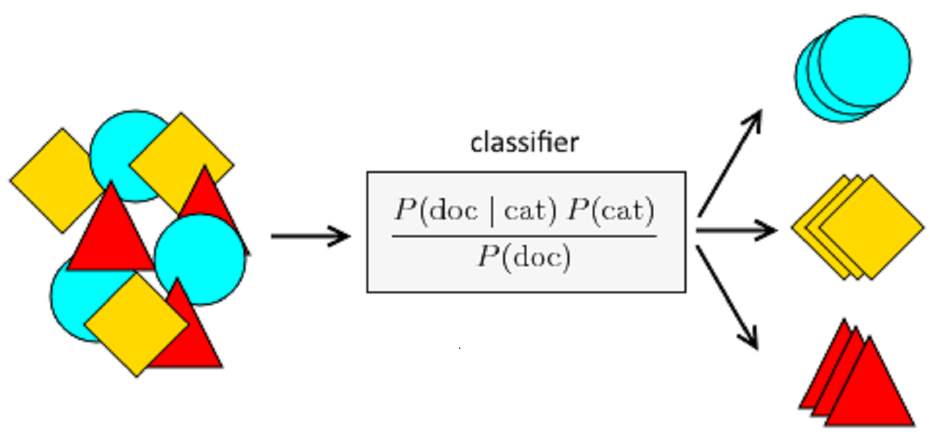
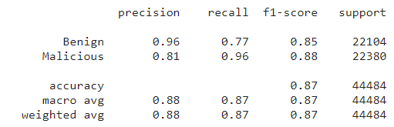
Classification ML Models Naive Bayes
Simple probabilistic classifier, often used for text classification. But, Sensitive to irrelevant features.

Slide 20
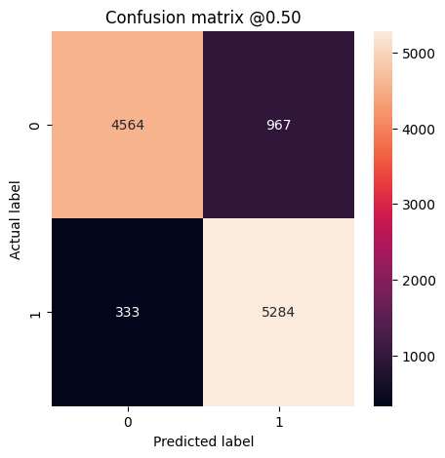
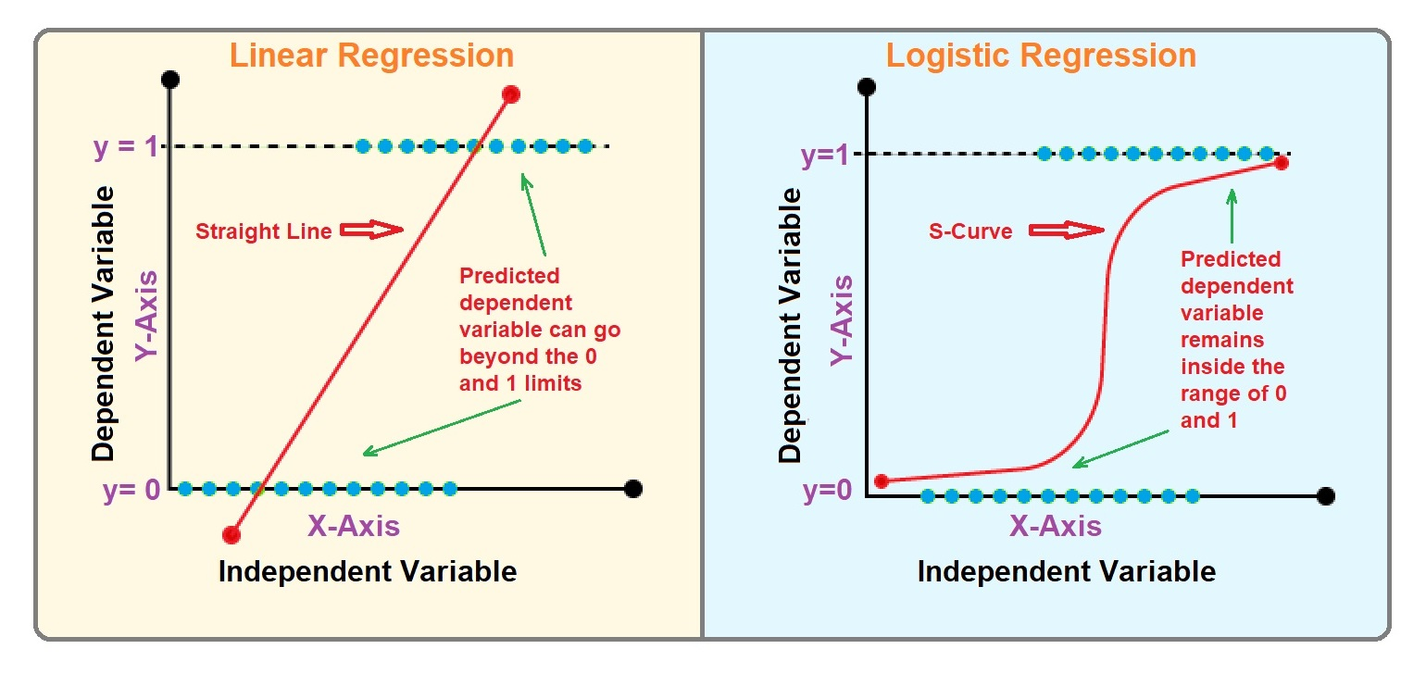
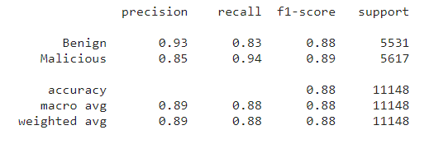
Classification ML Models Linear Regression
Linear model for binary and multiclass classification. But, May underperform complex models on non-linear data.

Slide 21
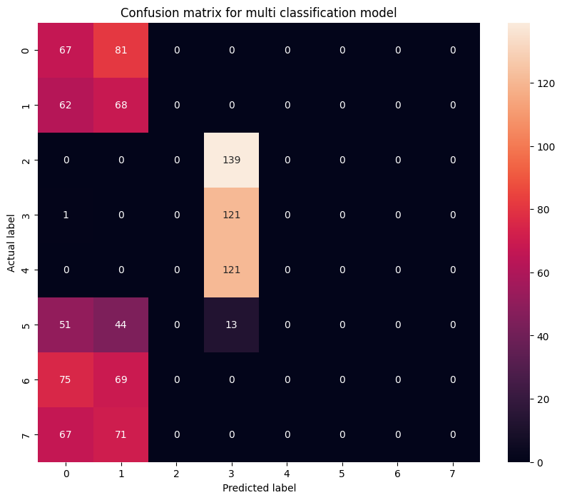
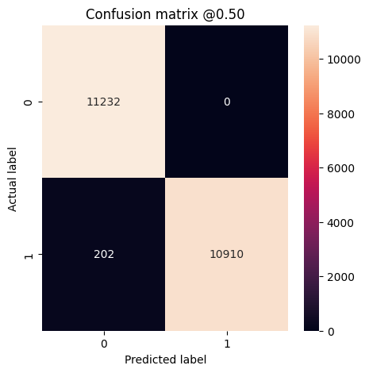
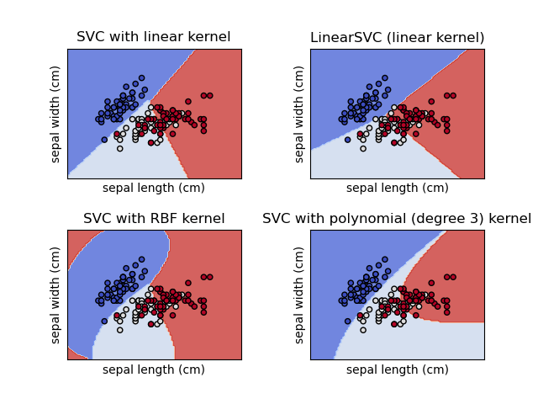
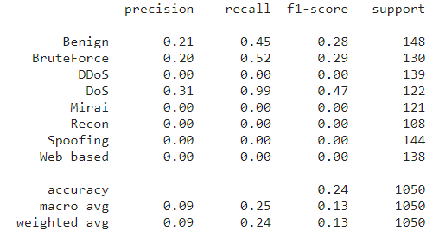
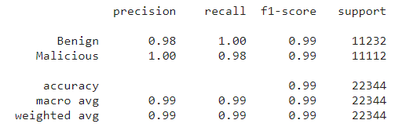
Classification ML Models Support Vector Machine (SVM)
Margin-maximizing classifier, powerful for binary and multiclass classification. But, Requires careful hyperparameter tuning, can be resource-intensive.

Slide 22
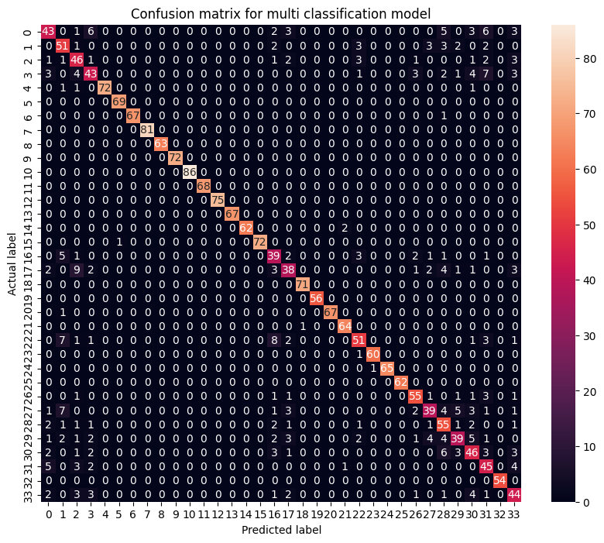
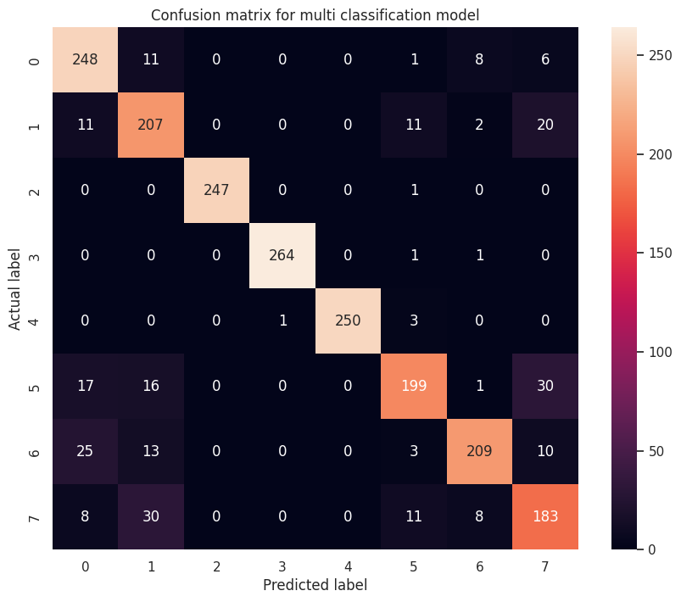
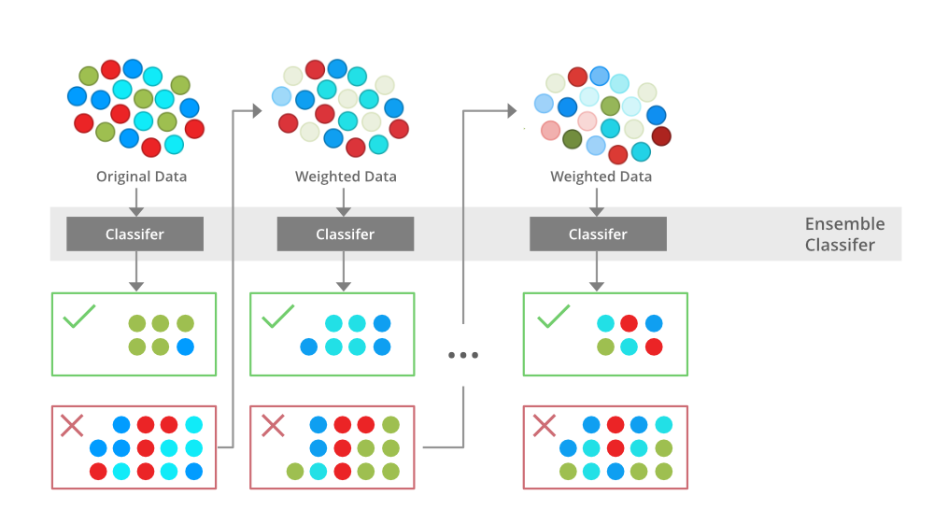
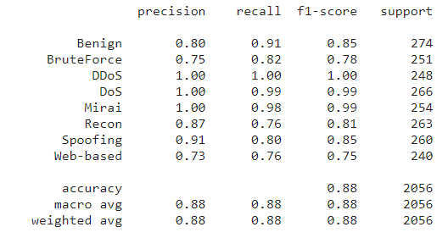
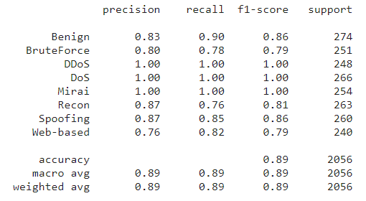
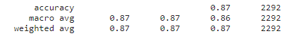
Classification ML Models XGBoost
Gradient boosting, robust, handles structured data well. But, may overfit small datasets.

Slide 23
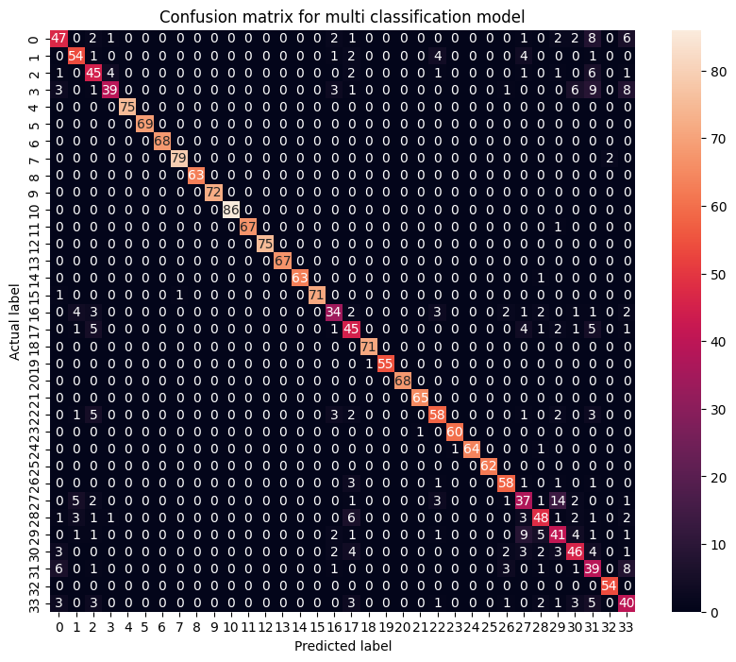
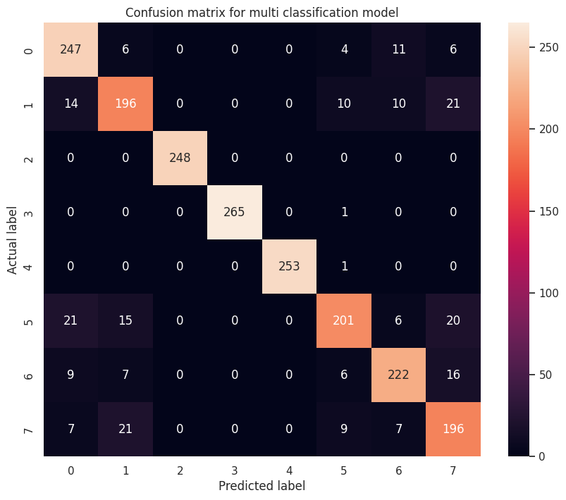
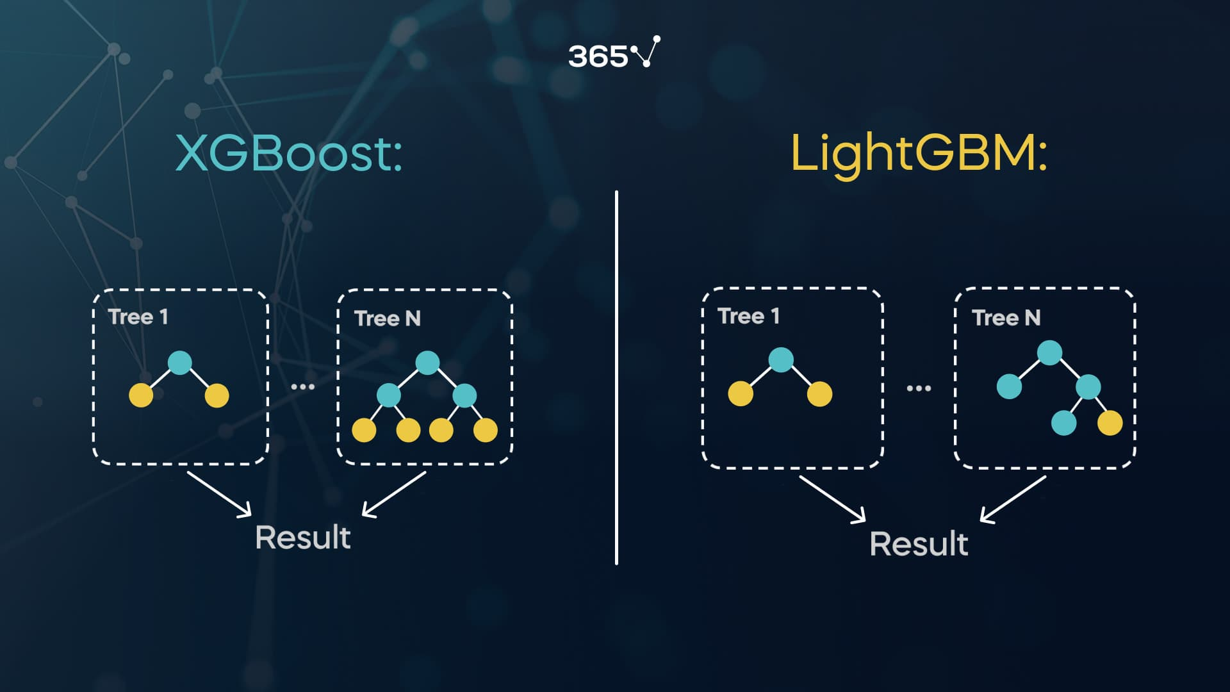
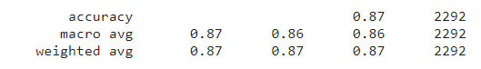
Classification ML Models LightGBM
Light, fast gradient boosting framework for large datasets. But, May require more data, sensitive to overfitting.

Slide 24
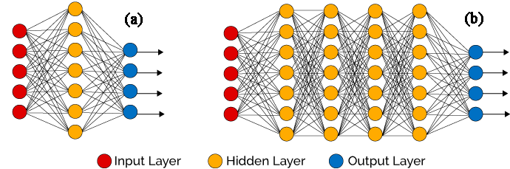
Classification DL Models Deep Neural Networks
Based on human brain design.
Different types for different problems:
Feedforward Neural Network (FNN): Basic, limited sequence modeling.
Convolutional Neural Network (CNN): Image and spatial data.
Recurrent Neural Network (RNN): Sequential data, variable length.
Long Short-Term Memory (LSTM): Handles vanishing gradients, good for sequences.
Convolutional LSTM (ConvLSTM): Combines spatial and sequential data.

Slide 25
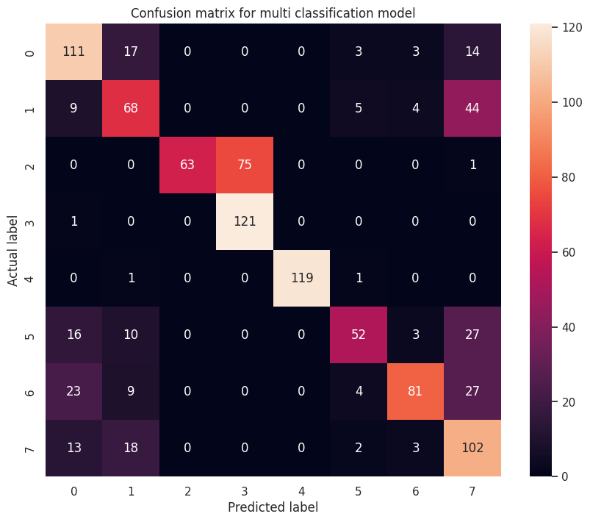
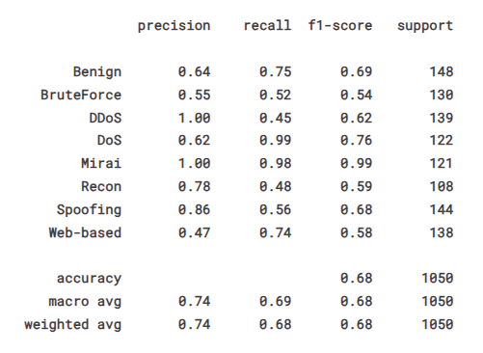
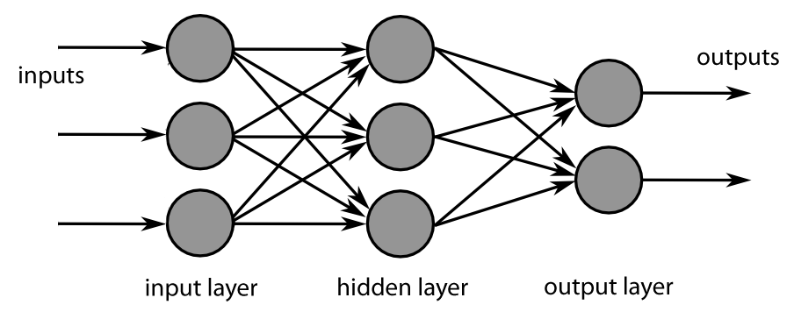
Classification DL Models
Feedforward Neural Network (FNN)
Feedforward Neural Networks (FNNs) are fundamental deep learning models. They lack sequence memory, making them ideal for simple tasks like image classification and regression. FNNs have widespread use across industries.

Slide 26
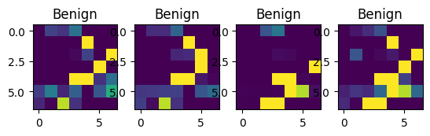
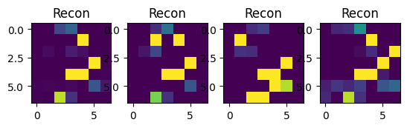
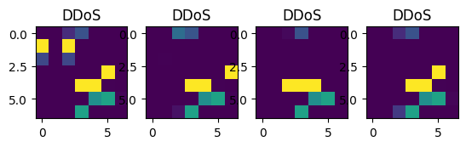
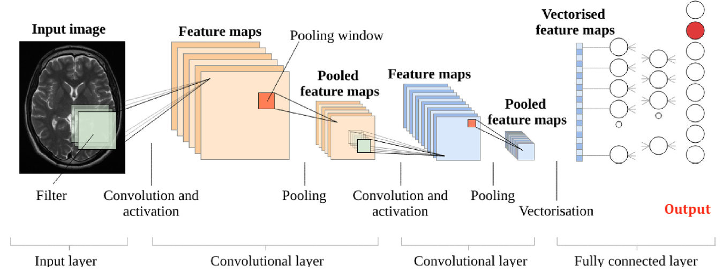

Classification DL Models
Convolutional Neural Network (CNN)
Convolutional Neural Networks (CNNs) are deep learning models for grid-like data like images. They excel in feature extraction and pattern recognition, impacting fields like autonomous driving and healthcare.
So what if we convert our packet data to images and then feed a CNN?

Slide 27


Classification DL Models
Convolutional Neural Network (CNN)
Clearly we miss something… The performance is not satisfying.

Slide 28
Models’ Performance Comparison
Model | 2 Classes (Binary) 60k samples |  | 8 Classes 3k samples |  | 34 Classes 10k samples
 | Inference Time | Accuracy | Inference Time | Accuracy | Inference Time | Accuracy
Naive Bayes | 5.8 e-4 | 0.86 | 20 e-4 | 0.26
LR | 11 e-4 | 0.89 | 15 e-4 | 0.25
SVM | 545 e-4 | 0.99 | 907 e-4 | 0.24
XGBoost | 80 e-4 | 1.00 | 159 e-4 | 0.88 | 480 e-4 | 0.87
LightGBoost | 55 e-4 | 1.00 | 474 e-4 | 0.89 | 2.281 e-4 | 0.87
FNN (DL)
CNN (DL)

Slide 29
Future Objectives

Slide 30

Deployment & ML-ops Kafka’s ecosystem

Slide 31

Deployment & ML-ops Lifecycle
All Dev-ML-Ops lifecycle needs are satisfied with apache kafka ecosystem.

Slide 32
Questions

